Slide 1
Subreddit Similar Interactions Network
Dipak Subramaniam
CS 590 SBN

Slide 2
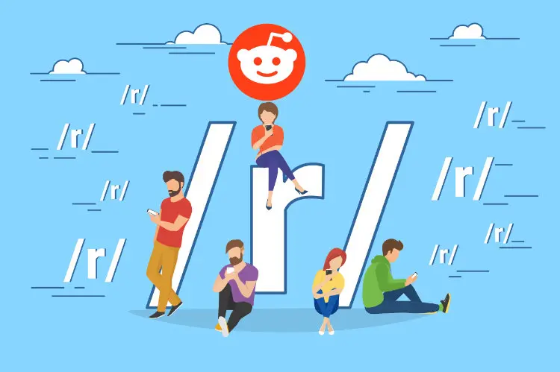
Big Picture
430m users, 2.8 million subreddit communities
Useful for staying up to date on the latest news, knowledge, trends, memes
Which subreddits overlap heavily?
Likelihood of posting/commenting

Slide 3
The Data
Rank | Subreddit name | # of subscribers
1 | /r/announcements | 153,972,327
2 | /r/funny | 40,442,903
3 | /r/AskReddit | 35,787,366
4 | /r/gaming | 32,799,784
5 | /r/aww | 31,092,097
6 | /r/Music | 29,758,361
7 | /r/pics | 28,482,511
8 | /r/science | 27,820,102
9 | /r/worldnews | 27,609,819
10 | /r/videos | 26,642,802
11 | /r/todayilearned | 26,500,738
12 | /r/movies | 26,414,252
13 | /r/news | 24,551,097
14 | /r/Showerthoughts | 24,622,523
15 | /r/EarthPorn | 21,815,057
16 | /r/gifs | 21,707,631
Rank | Subreddit name | # of subscribers
17 | /r/IAmA | 21,696,773
18 | /r/food | 21,631,790
19 | /r/askscience | 21,217,290
20 | /r/Jokes | 20,882,857
21 | /r/LifeProTips | 20,733,482
22 | /r/explainlikeimfive | 20,605,576
23 | /r/Art | 20,491,054
24 | /r/books | 20,347,275
25 | /r/mildlyinteresting | 19,479,815
26 | /r/nottheonion | 19,481,767
27 | /r/DIY | 19,416,881
28 | /r/sports | 19,383,761
29 | /r/blog | 18,983,596
30 | /r/space | 18,856,839
31 | /r/gadgets | 17,795,689
31 largest subreddits as of 2022
Scraped from oneupapp.io
User overlap of subreddits
Probability that r/subreddit_a user will post/comment on r/subreddit_b
Scraped from subredditstats.com (live)
Python, Selenium, NetworkX, Gephi

Slide 4
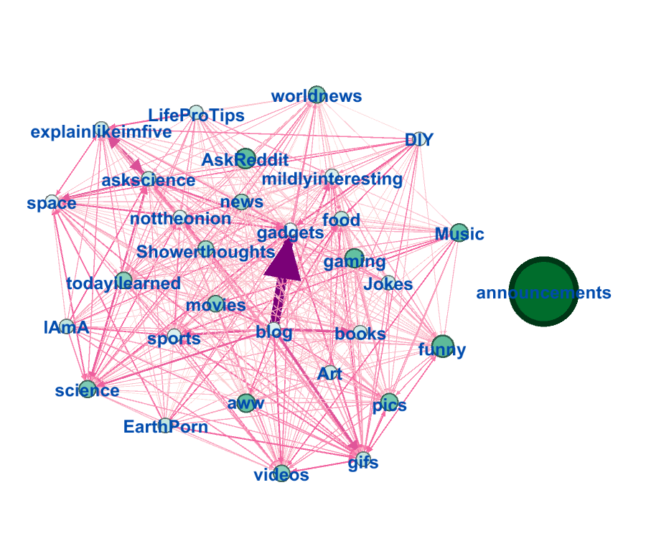
Network Setup
31 nodes, 580 directed links
Node weight: subscribers
Edge weight: probability that a user in the source subreddit will post/comment on the target subreddit
Diameter: 1
1 singleton, remaining network

Slide 5
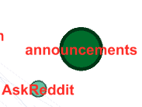
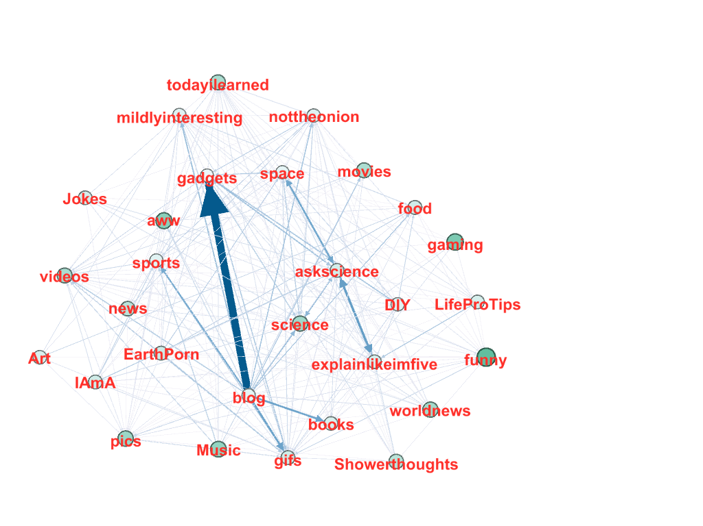
Global Properties
29 nodes, 337 links
Excluded link weights < 3
2 singletons removed
Diameter: 3 (ultra small-world)
1 component (after removal of 2 singletons)
Avg degree: 11.621
Avg weighted degree: 29.137
Density: 0.415
Modularity: 0.171
Avg path length: 1.4

Slide 6
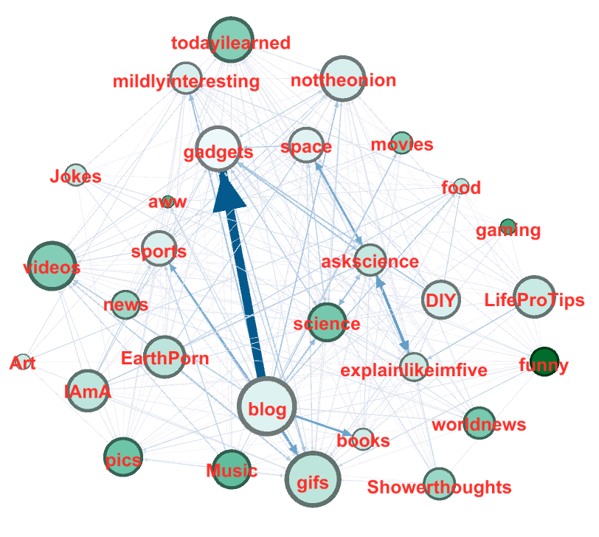
Important Nodes
Hubs:
Out-Degree: blog (19), gifs (18), videos (16) → influencers
In-Degree: gifs (28), gadgets (24), nottheonion (23) → popular destinations
Betweenness Centrality: gifs, gadgets, pics

Slide 7
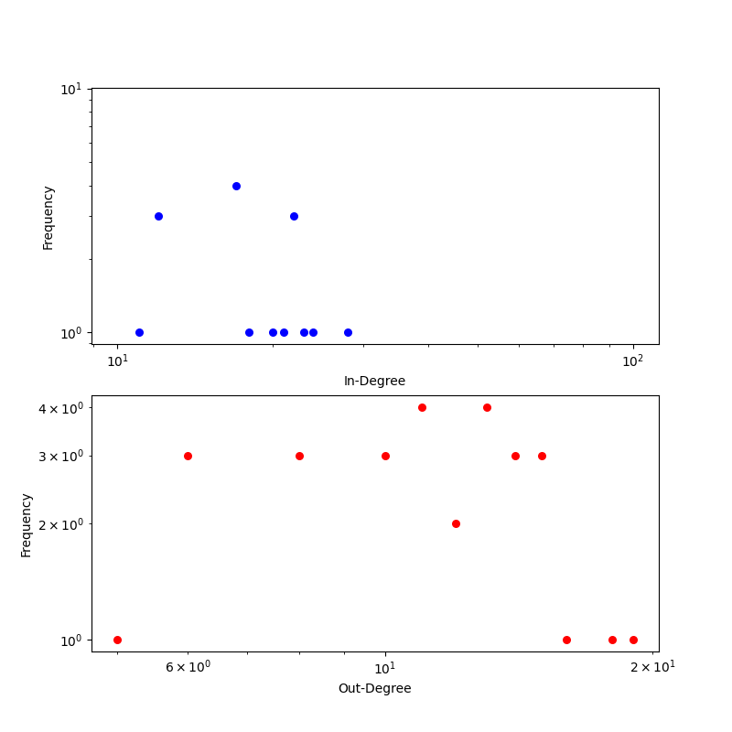
Degree Distribution

Slide 8
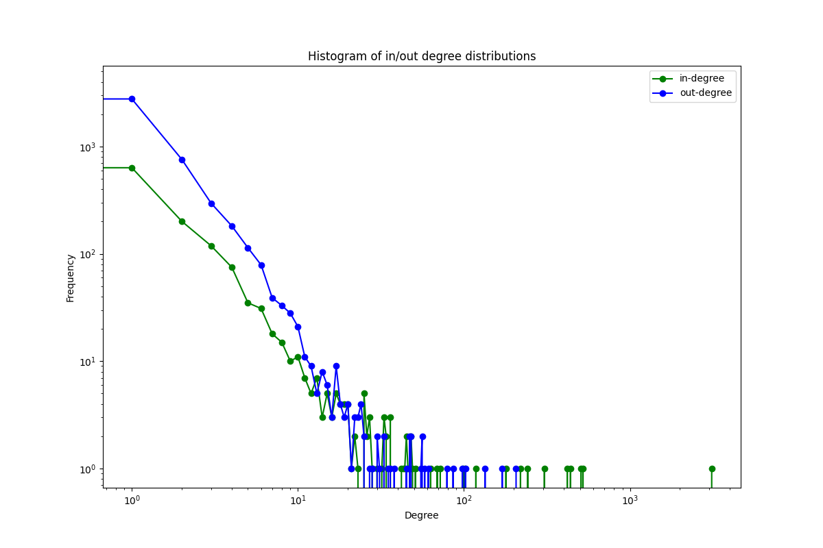
Degree Distribution

Slide 9
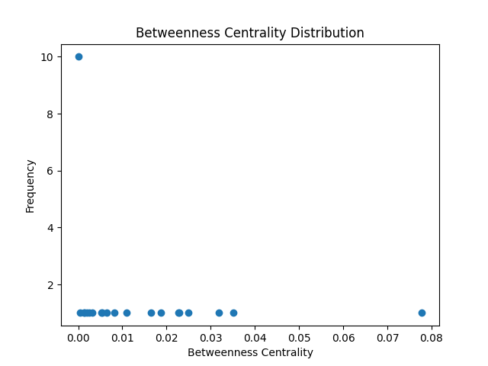
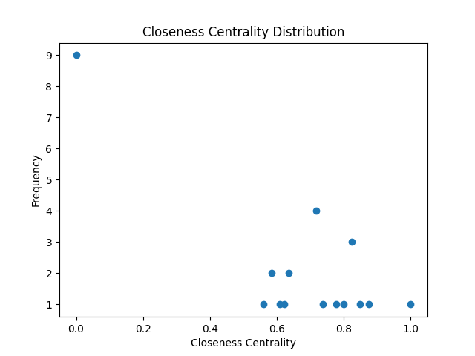
Centrality Distributions

Slide 10
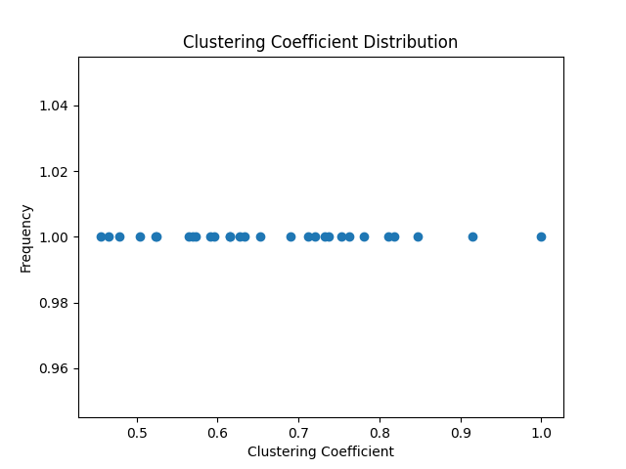
Clustering Coefficient Distribution
Avg CC: 0.604
Nodes highly connected to neighbors, many triangles
Representative of small-world

Slide 11
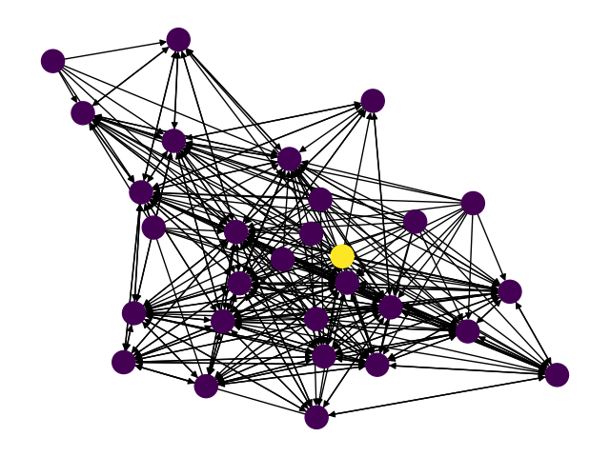
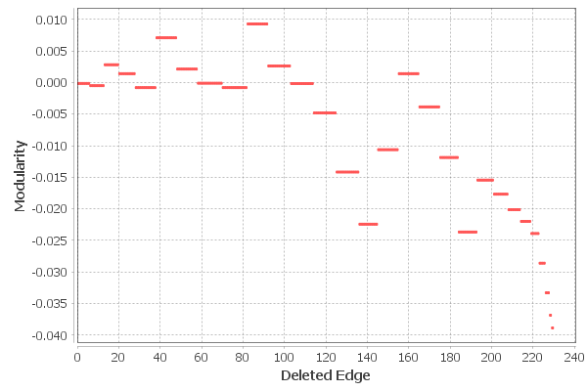
Girvan-Newman Clustering

Slide 12
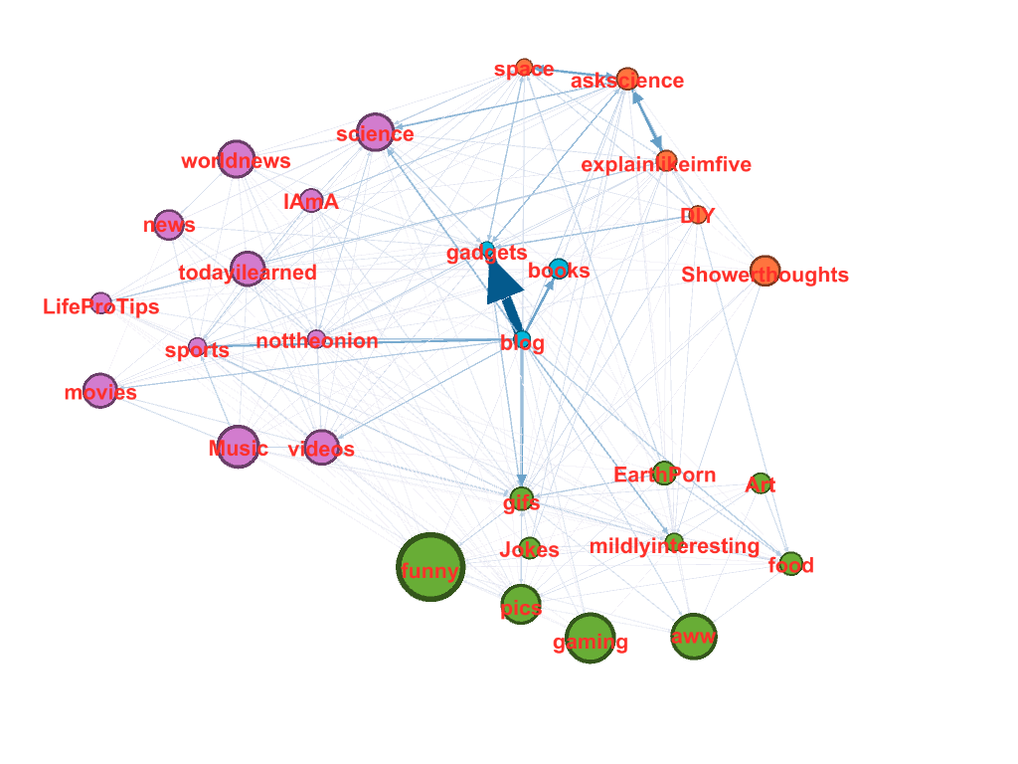
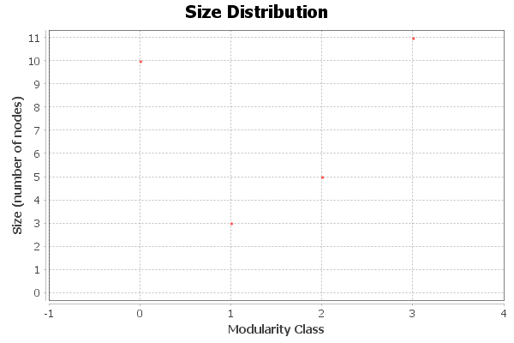
Louvain Clustering
Modularity: 0.171, 4 communities

Slide 13
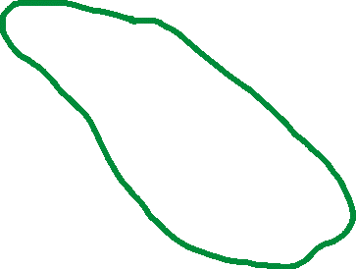



Clusters
Science/
Explanations
News/Pop Culture
General Info/Discussions
Humor/
Engaging Media Content

Slide 14
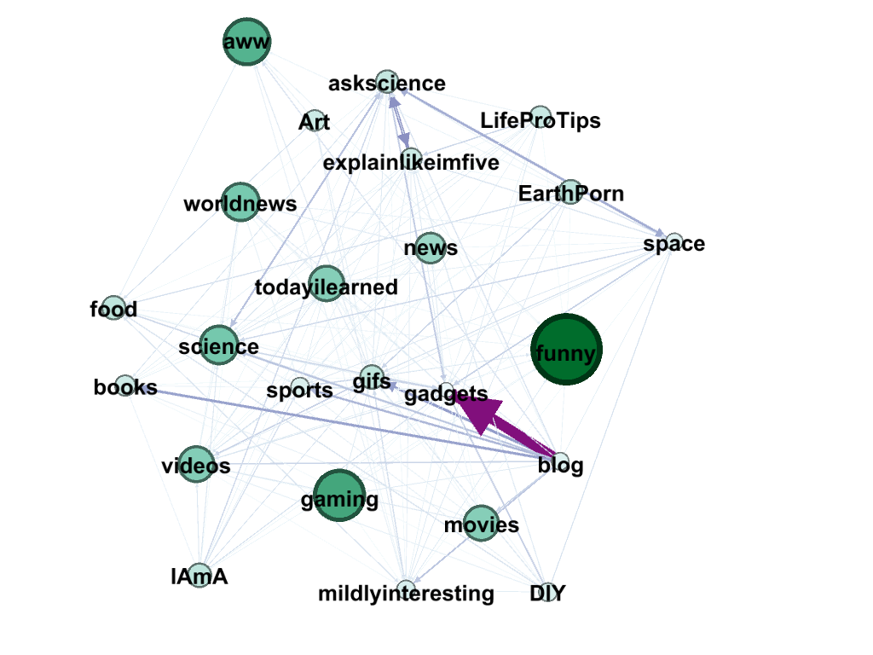
Resilience – Random Attack
Original
5 Random Nodes Attacked

Slide 15
Random Attack
24 nodes, 286 links
Original: 29 nodes, 337 links
Diameter: still 3
Avg degree: 11.917
Avg weighted degree: 78.428
Density: 0.518
Modularity: 0.13
Avg path length: 1.314
Avg clustering coeff: 0.635

Slide 16
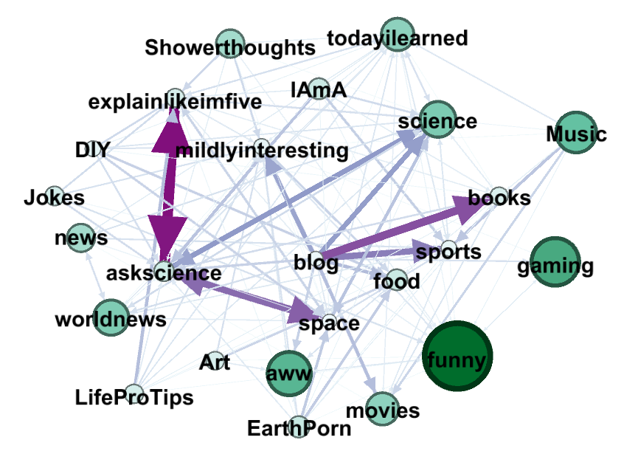
Resilience – Targeted Attack
Original
5 Highest BC Nodes Attacked

Slide 17
Targeted Attack
24 nodes, 160 links
Original: 29 nodes, 337 links
Diameter: 3
Avg degree: 6.667
Avg weighted degree: 34.483
Density: 0.29
Modularity: 0.215
Avg path length: 1.67
Avg clustering coeff: 0.489

Slide 18
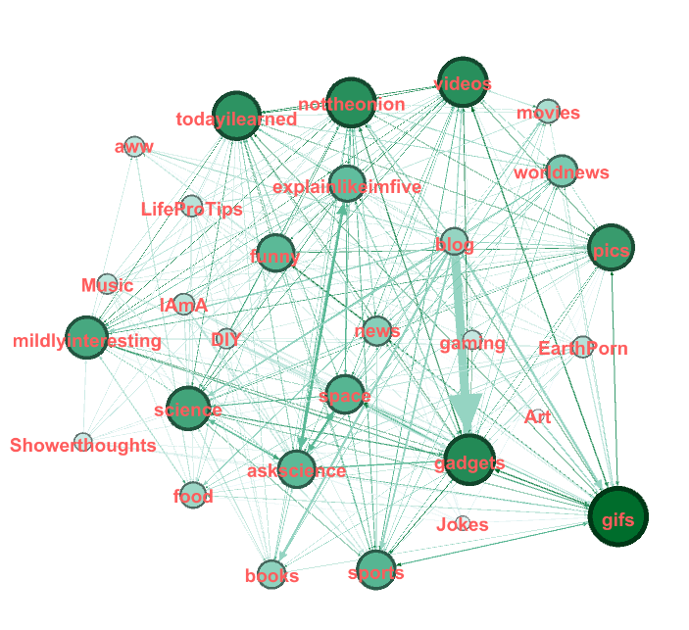
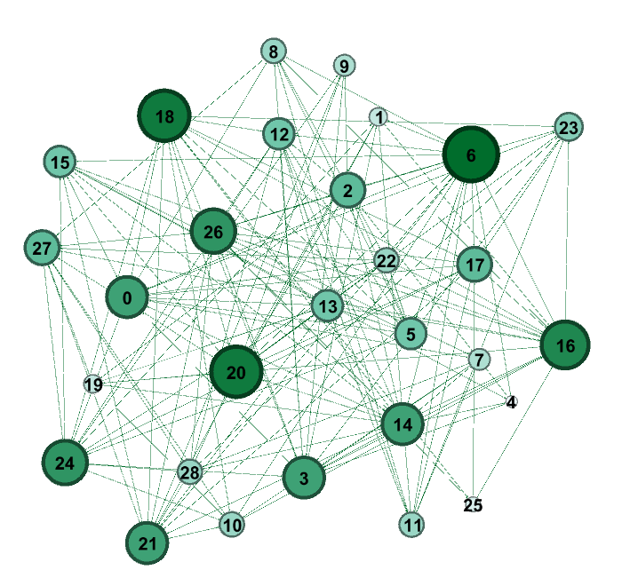
Network Comparisons
Original
Random Network (p=0.3)

Slide 19
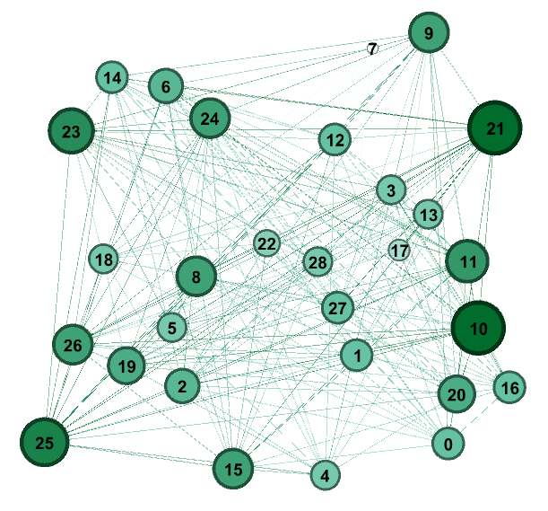
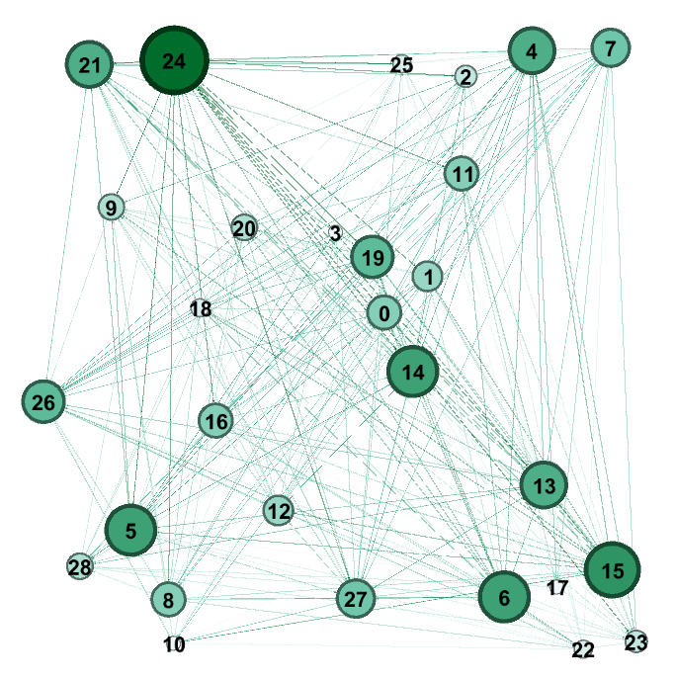
Network Comparisons
Random Network (p=0.4)
Random Network (p=0.5)

Slide 20
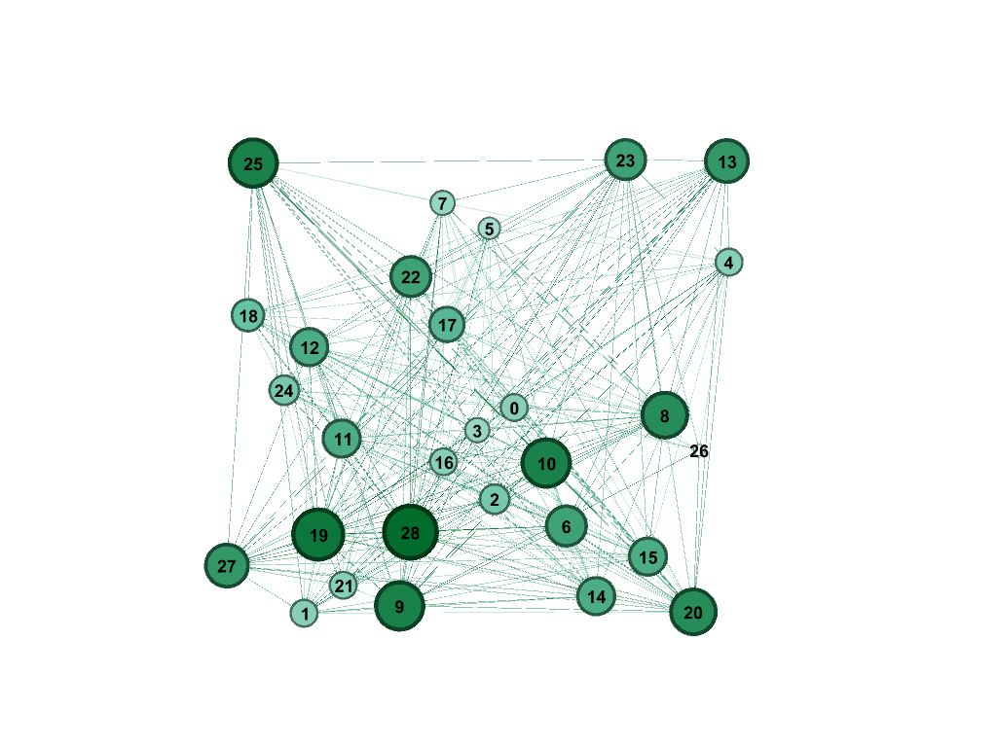
Network Comparisons
Original
Erdos-Renyi Network (p=0.5)

Slide 21
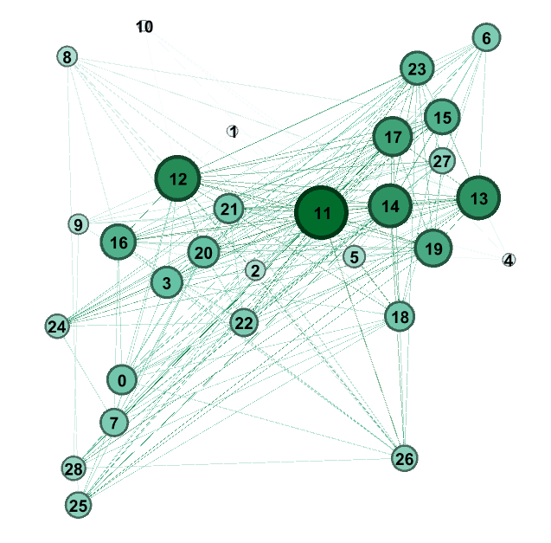
Network Comparisons
Original
Barabasi-Albert Network

Slide 22
Network Nature
K max = K min * N ^ (1 / γ - 1)
46 = 6 * (29) ^ (1 / γ – 1)
γ = 2.65, 2 < γ < 3 → Scale Free
Hubs present
Distribution of links to nodes follows a power law

Slide 23
Conclusions
Scale Free
Top 21 subreddits have reasonable overlap
Some nodes extremely tied together by likelihood to post/comment
Expand network size, include top 100 or more subreddits
Using ParseHub

Slide 24
Questions?

